Slide 1
Overview Of A Liferay Portal Content Management System
Javeed Chida

Slide 2
Objectives
To help you understand :
the difference between a portlet and web content
what a portal is
the need for structures and templates
…and the difference between them

Slide 3
What is a portal?

Slide 4
What is a portal?
What is a portlet?

Slide 5
What is a portal?
What is a portlet?
What is a web content item?

Slide 6
What is a portal?
What is a portlet?
What is a web content item?

Slide 7
What is a portal?
What is a portlet?
What is a web content item?
A unit of information displayed on the website.

Slide 8
What is a portal?
What is a portlet?
What is a web content item?
A unit of information displayed on the website.
Can be as simple as a rich text field, or several fields (rich text, image, link to a document, etc.)

Slide 9
What is a portal?
What is a portlet?
What is a web content item?
A unit of information displayed on the website.
Can be as simple as a rich text field, or several fields (rich text, image, link to a document, etc.)
Structure

Slide 10
What is a portal?
What is a portlet?
What is a web content item?
A unit of information displayed on the website.
Can be as simple as a rich text field, or several fields (rich text, image, link to a document, etc.)
Structure
Template

Slide 11

What is a portal?
What is a portlet?
What is a web content item?
A unit of information displayed on the website.
Can be as simple as a rich text field, or several fields (rich text, image, link to a document, etc.)
Structure
Template

Slide 12

What is a portal?
What is a portlet?
What is a web content item?
A unit of information displayed on the website.
Can be as simple as a rich text field, or several fields (rich text, image, link to a document, etc.)
Structure
Template

Slide 13


What is a portal?
What is a portlet?
What is a web content item?
A unit of information displayed on the website.
Can be as simple as a rich text field, or several fields (rich text, image, link to a document, etc.)
Structure
Template

Slide 14


What is a portal?
What is a portlet?
What is a web content item?
A unit of information displayed on the website.
Structure
Can be as simple as a rich text field, or several fields (rich text, image, link to a document, etc.)
Template

Slide 15

What is a portal?
What is a portlet?
What is a web content item?
A unit of information displayed on the website.
Structure
Can be as simple as a rich text field, or several fields (rich text, image, link to a document, etc.)
Template

Slide 16

What is a portal?
What is a portlet?
What is a web content item?
A unit of information displayed on the website.
Structure
Can be as simple as a rich text field, or several fields (rich text, image, link to a document, etc.)
Template

Slide 17




What is a portal?
What is a portlet?
What is a web content item?
A unit of information displayed on the website.
Structure
Can be as simple as a rich text field, or several fields (rich text, image, link to a document, etc.)
Template

Slide 18

What is a portal?
What is a portlet?
What is a web content item?
A unit of information displayed on the website.
Structure
Can be as simple as a rich text field, or several fields (rich text, image, link to a document, etc.)
Template

Slide 19
WHY!?!

Slide 20
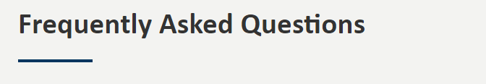
A simple web content item

Slide 21
A simple web content item

Slide 22
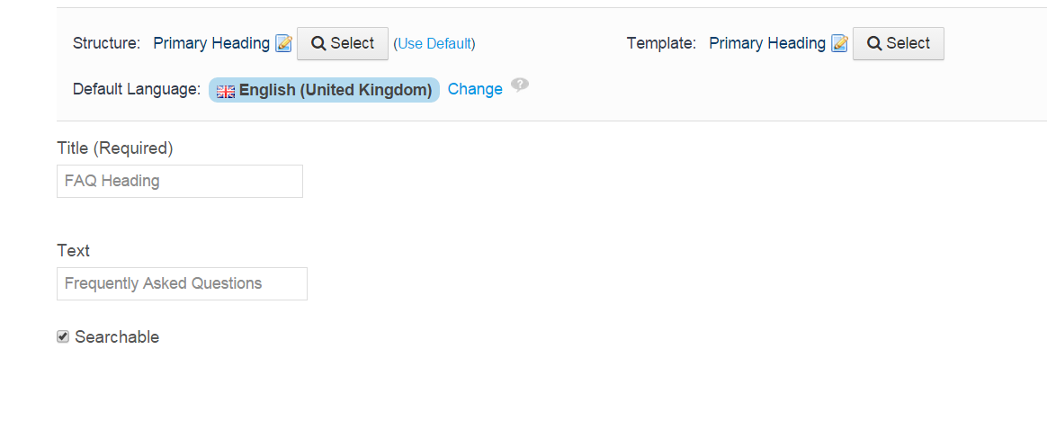
A simple web content item

Slide 23

A complex web content item

Slide 24
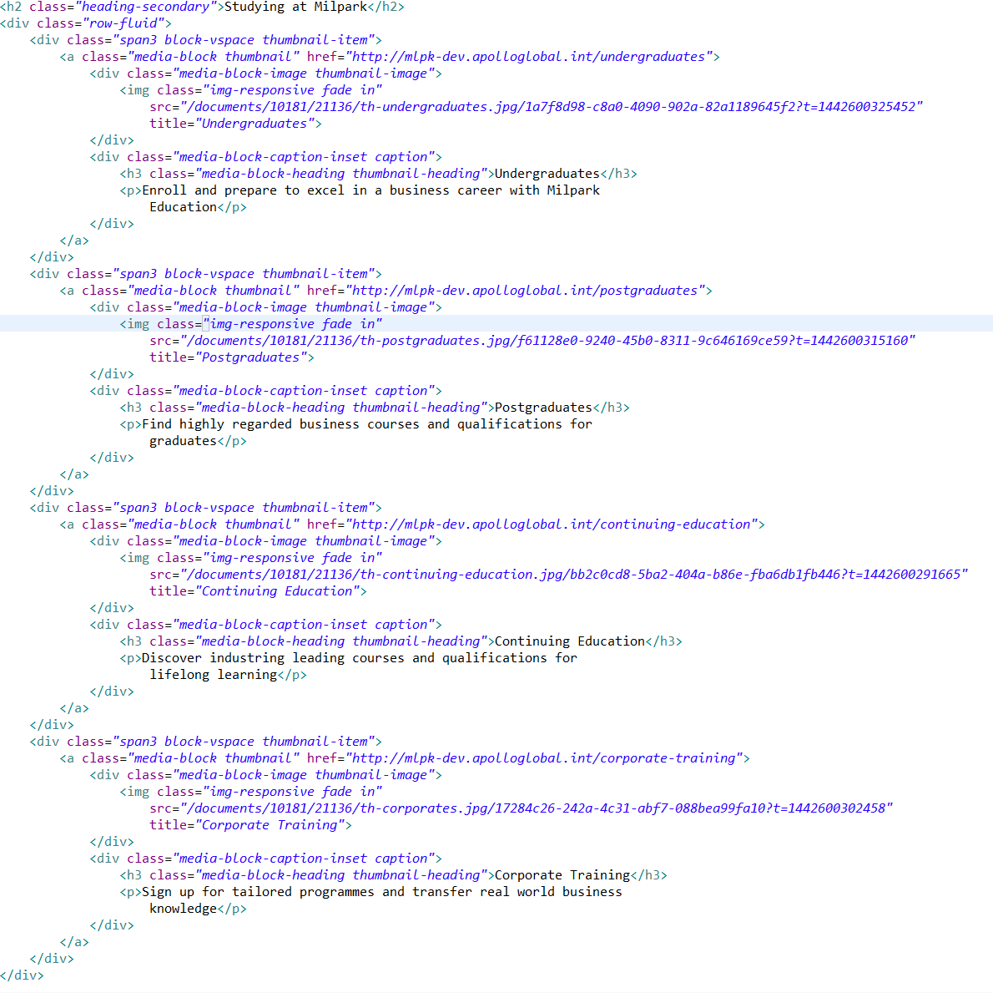
A complex web content item

Slide 25
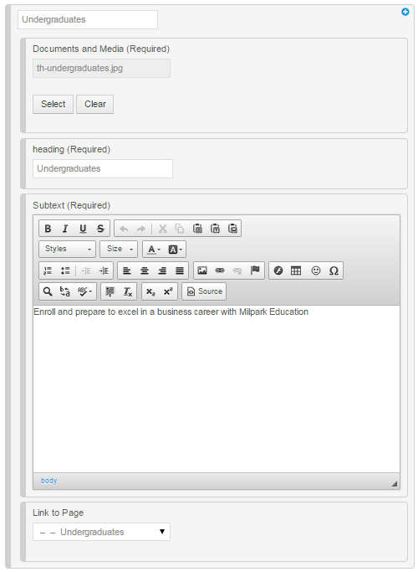
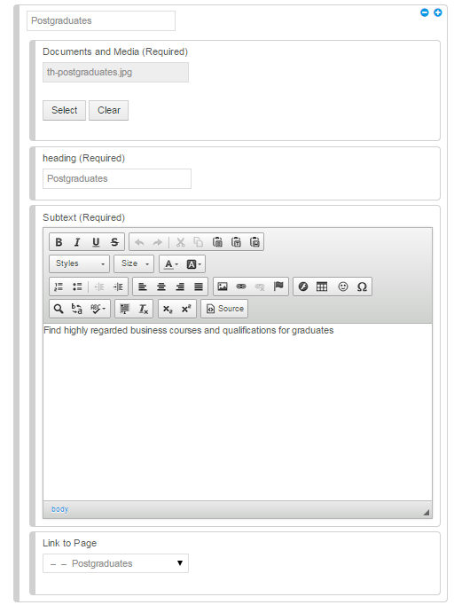
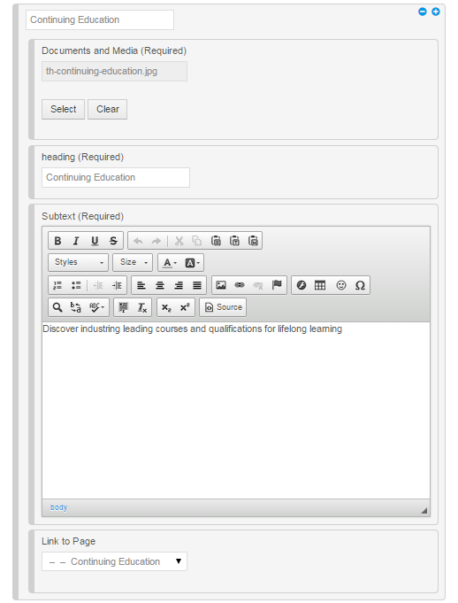
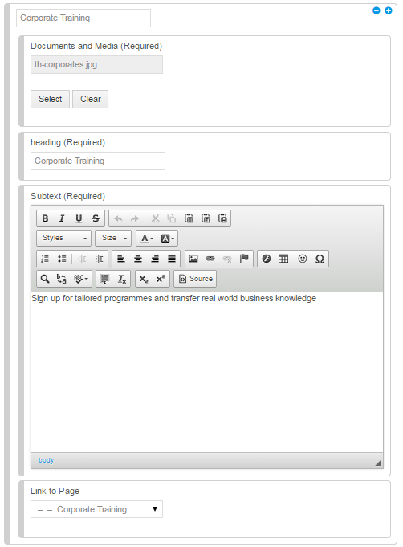
A complex web content item

Slide 26
What is a portal?
What is a portlet?
What is a web content item?
A unit of information displayed on the website.
Can be as simple as a rich text field, or several fields (rich text, image, link to a document, etc.)
Structure
Template

Slide 27
What is a portal?
What is a portlet?
What is a web content item?
A unit of information displayed on the website.
Can be as simple as a rich text field, or several fields (rich text, image, link to a document, etc.)
Structure
Template
AKA ‘Journal Article’
(Liferay jargon)

Slide 28
What is a portal?
What is a portlet?
What is a web content item?
A unit of information displayed on the website.
Can be as simple as a rich text field, or several fields (rich text, image, link to a document, etc.)
Not to be confused with ‘document’
Structure
Template
AKA ‘Journal Article’
(Liferay jargon)

Slide 29
What is a portal?
What is a portlet?
What is a web content item?
A unit of information displayed on the website.
Can be as simple as a rich text field, or several fields (rich text, image, link to a document, etc.)
Not to be confused with ‘document’
Structure
Template
Content repository
AKA ‘Journal Article’
(Liferay jargon)

Slide 30
What is a portal?
What is a portlet?
What is a web content item?
A unit of information displayed on the website.
Can be as simple as a rich text field, or several fields (rich text, image, link to a document, etc.)
Not to be confused with ‘document’
Structure
Template
Content repository
Document repository
AKA ‘Journal Article’
(Liferay jargon)

Slide 31
What is a portal?
What is a portlet?
What is a web content item?
A unit of information displayed on the website.
Gets versioned
when it is updated
Can be as simple as a rich text field, or several fields (rich text, image, link to a document, etc.)
Not to be confused with ‘document’
Structure
Template
Content repository
Document repository
AKA ‘Journal Article’
(Liferay jargon)

Slide 32





Building Up To A Metaphor
Think of CONTENT as movie posters
Each web content item is a movie poster

Slide 33
What is a portal?
What is a portlet?
What is a web content item?

Slide 34
What is a portal?
What is a portlet?
What is a web content item?
A web application that can be added to a page of a portal

Slide 35
What is a portal?
What is a portlet?
What is a web content item?
A web application that can be added to a page of a portal
Configurable

Slide 36
What is a portal?
What is a portlet?
What is a web content item?
A web application that can be added to a page of a portal
Configurable
E.g. a portlet can have a border

Slide 37
What is a portal?
What is a portlet?
What is a web content item?
A web application that can be added to a page of a portal
Configurable
Reusable

Slide 38
What is a portal?
What is a portlet?
What is a web content item?
A web application that can be added to a page of a portal
Configurable
Reusable
More than 90% of website
is 2 portlets

Slide 39
What is a portal?
What is a portlet?
What is a web content item?
A web application that can be added to a page of a portal
Configurable
Reusable
More than 90% of website
is 2 portlets
Web Content
Display Portlet

Slide 40
What is a portal?
What is a portlet?
What is a web content item?
A web application that can be added to a page of a portal
Configurable
Reusable
More than 90% of website
is 2 portlets
Web Content
Display Portlet
Asset Publisher
Portlet

Slide 41
What is a portal?
What is a portlet?
What is a web content item?
A web application that can be added to a page of a portal
Configurable
Reusable
More than 90% of website
is 2 portlets
Web Content
Display Portlet
Asset Publisher
Portlet
1 web content item

Slide 42
What is a portal?
What is a portlet?
What is a web content item?
A web application that can be added to a page of a portal
Configurable
Reusable
More than 90% of website
is 2 portlets
Web Content
Display Portlet
Asset Publisher
Portlet
1 web content item
MANY web content items

Slide 43
What is a portal?
What is a portlet?
What is a web content item?
A web application that can be added to a page of a portal
Configurable
Reusable
Portable

Slide 44
What is a portal?
What is a portlet?
What is a web content item?
A web application that can be added to a page of a portal
Configurable
Portlets we use
Web Content Display
Asset Publisher
Search
IFrame
Login
Reusable
Portable

Slide 45
Back To The Metaphor
So, if each web content item were a movie poster:

Slide 46
Back To The Metaphor
WHAT WOULD A PORTLET BE?
?
CONTENT
PORTLET

Slide 47
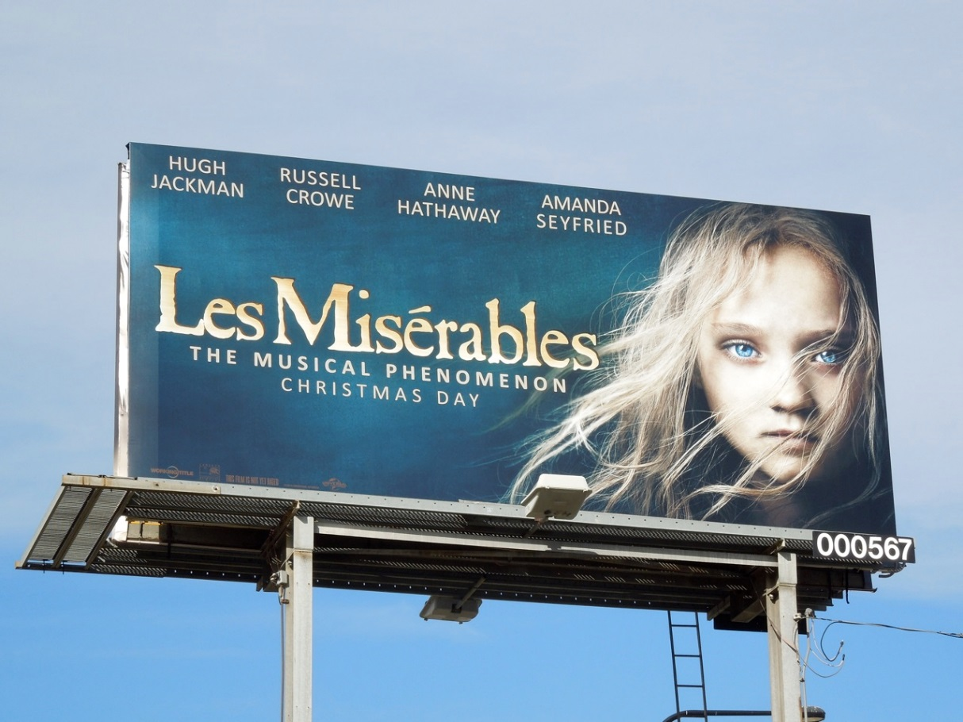
Back To The Metaphor
BILLBOARD?

Slide 48
What is a portal?
What is a portlet?
What is a web content item?

Slide 49
What is a portal?
What is a portlet?
What is a web content item?
A collection of pages

Slide 50
What is a portal?
What is a portlet?
What is a web content item?
A collection of pages
Where each page is a collection of portlets

Slide 51
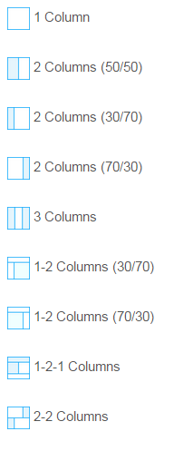
What is a portal?
What is a portlet?
What is a web content item?
A collection of pages
Where each page is a collection of portlets
Examples of Page Layouts

Slide 52
What is a portal?
What is a portlet?
What is a web content item?
A collection of pages
Where each page is a collection of portlets
Examples of Page Layouts
In each column, portlets stack vertically

Slide 53
What is a portal?
What is a portlet?
What is a web content item?
A collection of pages
Where each page is a collection of portlets
A portal has a theme

Slide 54
What is a portal?
What is a portlet?
What is a web content item?
A collection of pages
Where each page is a collection of portlets
A portal has a theme
logo
header
search box
navigation menus

Slide 55
What is a portal?
What is a portlet?
What is a web content item?
A collection of pages
Where each page is a collection of portlets
A portal has a theme
A portal has users

Slide 56
In Summary:

Slide 57
In Summary:
The portal site has pages

Slide 58
In Summary:
The portal site has pages
Each page has a specific layout

Slide 59
In Summary:
The portal site has pages
Each page has a specific layout
Each page has portlets distributed into its layout’s containers

Slide 60
In Summary:
The portal site has pages
Each page has a specific layout
Each page has portlets distributed into its layout’s containers
Each portlet is a web application: configurable, reusable, portable

Slide 61
In Summary:
The portal site has pages
Each page has a specific layout
Each page has portlets distributed into its layout’s containers
Each portlet is a web application: configurable, reusable, portable
More than 90% of a website can be built using instances of 2 portlets

Slide 62
In Summary:
The portal site has pages
Each page has a specific layout
Each page has portlets distributed into its layout’s containers
Each portlet is a web application: configurable, reusable, portable
More than 90% of a website can be built using instances of 2 portlets
Web Content Display Portlet can be configured to display one web content item

Slide 63
In Summary:
The portal site has pages
Each page has a specific layout
Each page has portlets distributed into its layout’s containers
Each portlet is a web application: configurable, reusable, portable
A rich, content-driven website can be built using multiple instances of 2 portlets
Web Content Display Portlet: can be configured to display one web content item
Asset Publisher Portlet: can be configured to display multiple web content items meeting specified conditions

